Slide 2
Welcome to CS61B!
We’re going to do some cool things here :)

Slide 3
CS61B in a Nutshell
This is a data structures course!
We’ll be covering a variety of topics in this course: debugging, linked lists, hash tables, asymptotics, and a lot more!
In this course, we’ll also be focusing on efficiency of writing and running programs.

Slide 4
Introductions!

Slide 5
Announcements

Slide 6
Announcements
Homework 0A is due Friday, 8/30 at 11:59 pm
Lab01 is due Friday, 8/30 at 11:59 pm
Homework 0B is due Tuesday 9/3 at 11:59 pm
Pre-Semester Survey is due Friday 9/6 at 11:59pm
Project 0 is due Friday 9/6 at 11:59 pm
Beyond these deadlines, please make sure to read through the syllabus in its entirety and ensure that you understand the policies (you will need to read through it for lab01).

Slide 7
Announcements - What to expect during lab
We use oh.datastructur.es to queue up. Questions are welcome!
We tend to lead you to the answer, rather than give it to you right away. Today is setup, so we’ll be more direct, but we expect you to think more in future labs!
Additionally, we generally only take lab-related questions in lab sections. For help on other assignments, go to office hours, which usually runs concurrently alongside labs.

Slide 8
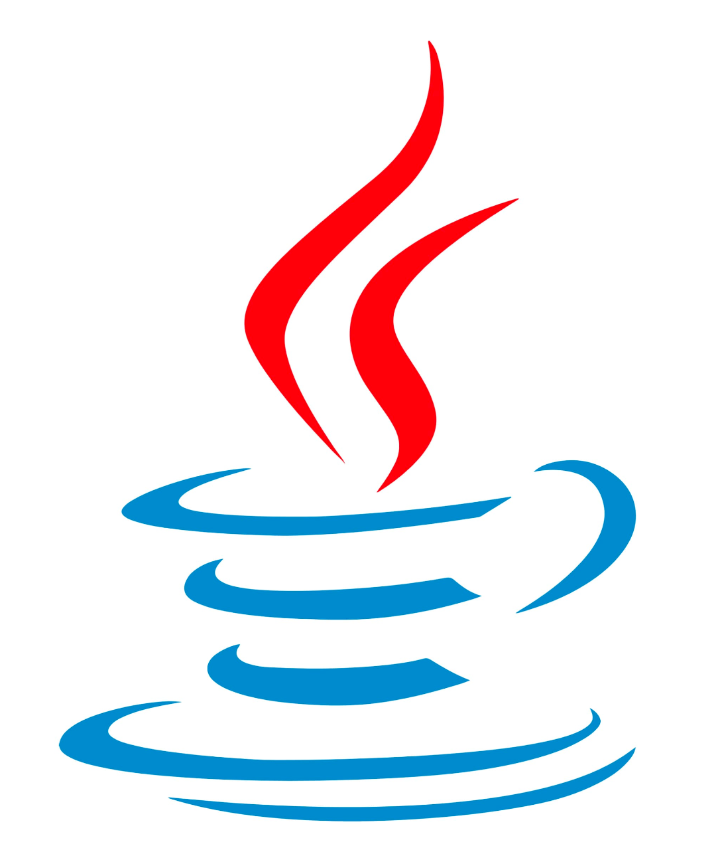
Java Basics
Notes:
These slides cover the very basics of the Java syntax language - they’re skippable, as it’s something I think most students are able to pick up on as they work through the assignments and will be covered more in-depth in lecture and in homework 0. They’re left here for students if they want to revisit.

Slide 9
Python: HelloWorld
print(“Hello World!”)
Notes:
I want to emphasize that not everyone is going to necessarily have Python coming into this course (while some students will because of CS61A, keep in mind that some students don’t necessarily have the same background, especially given this is a summer course). When introducing this part of the slide, make sure to double check that people are following along (and that they understand that the above is just printing out a statement and the general syntax used in Python) and that they mainly understand the specific syntax of Java and its rules (that is the main purpose of this slide, to be used as a comparison).

Slide 10
Java: HelloWorld
public class HelloWorld {
public static void main(String[] args) {
System.out.println("Hello World!");
}
}
So, what’s special about Java? Let’s walk through this!

Slide 11
Java: HelloWorld
public class HelloWorld {
public static void main(String[] args) {
System.out.println("Hello World!");
}
}
This denotes that you’re creating a class. Everything in Java lives in a class!

Slide 12
Java: HelloWorld
public class HelloWorld {
public static void main(String[] args) {
System.out.println("Hello World!");
}
}
The name of the class is HelloWorld.

Slide 13
Java: HelloWorld
public class HelloWorld {
public static void main(String[] args) {
System.out.println("Hello World!");
}
}
The method name here is main, where the code to print “Hello World!” is executed.

Slide 14
Java: HelloWorld
public class HelloWorld {
public static void main(String[] args) {
System.out.println("Hello World!");
}
}
This is the statement to print “Hello World!”. Notice that it ends with a ; (used to separate statements).

Slide 15
Java: HelloWorld
public class HelloWorld {
public static void main(String[] args) {
System.out.println("Hello World!");
}
}
The brackets denote sections of code (i.e. the method belongs inside of the class).

Slide 16

Git(hub)

Slide 17
Git
Git is a distributed version control system.
Notes:
There is a lot of information here to digest here, so come prepared if students do ask a lot of questions here.

Slide 18
Git
Git is a distributed version control system.
What does that mean?
Version Control System: Tracks all changes to files over time.
Distributed: Every developer’s computer stores the entire history of the project.
The entire history of a project is called a repository.
Notes:
There is a lot of information here to digest here, so come prepared if students do ask a lot of questions here.

Slide 19
Git
Git is a distributed version control system.
What does that mean?
Version Control System: Tracks all changes to files over time.
Distributed: Every developer’s computer stores the entire history of the project.
The entire history of a project is called a repository.
Throughout this course, you’ll be using Github to host all your work and to submit your assignments. And with Git, you’ll be able to push all your work onto Github.
Notes:
There is a lot of information here to digest here, so come prepared if students do ask a lot of questions here.

Slide 20
The Main Git Commands You Should Know
git init: Initializes a git repository in current directory.
git add <file_name>: Adds a file to staging (to be committed).
git commit -m “Message”: Saves all staged files into a commit (like a snapshot of your current repository)
git status: Displays state of the repository and staging area (tracked, untracked files and changes).
git log: Displays the history of our committed history.
Notes:
There is a lot of information here to digest here, so come prepared if students do ask a lot of questions here.
More Notes:
git init: Tells the git version control system that we want to track the history of our current directory.

Slide 21
Git Commands Continued
git restore: Restores files to their versions in the most recent commit.
git restore --source=[commitID]: Restores files to their versions in the given commit.
git push <repo> <branch>: Takes commits on your local computer and pushes it into the remote repository (git push origin main)
git pull <repo> <branch>: Pulls any changes from the remote repository onto your computer (git pull skeleton main)
Visualization: https://git-school.github.io/visualizing-git/#free-remote
Notes:
There is a lot of information here to digest here, so come prepared if students do ask a lot of questions here.

Slide 22

Local Repository
Remote Repository
Boba.txt
Name of the file.
I love boba.
Contents of the file.
Let’s say we have a file called Boba.txt in your local repository (you can think of your repository as another file on your local computer).

Slide 23
Local Repository
Remote Repository
Staging Area
Boba.txt
I love boba.
Let’s run the following:
git add Boba.txt
We’ve now added the file to the staging area (aka, to be committed).

Slide 24
Local Repository
Remote Repository
Boba.txt
I love boba.
Let’s run the following now:
git commit -m “Done!”
At this point, we’ve taken a snapshot - the files in the staging area have been tracked by our local repository.

Slide 25
Local Repository
Remote Repository
Boba.txt
Boba.txt
I love boba.
I love boba.
In the event that we somehow lose our laptop, we want to be sure we saved our work and progress - so we add our work into a remote repository:
git push origin main
Notes:
Note: git push origin main is the main command they’ll be using throughout to push their work into their remote repository (keep in mind that it is following the syntax of the command, where origin is the repository name and main is the branch name). Make sure to clarify to students if needed or if questions arise.

Slide 26
Local Repository
Remote Repository
Boba.txt
Boba.txt
I love boba.
I love boba.
At this point, we’ve saved our progress into our remote repository! Whoo! If we ever want to get something from our remote to local repository, we would use git pull [repo] [branch]
Notes:
Note: The general command they use would be git pull skeleton main when they’re getting the starting files for labs, projects, etc.

Slide 27
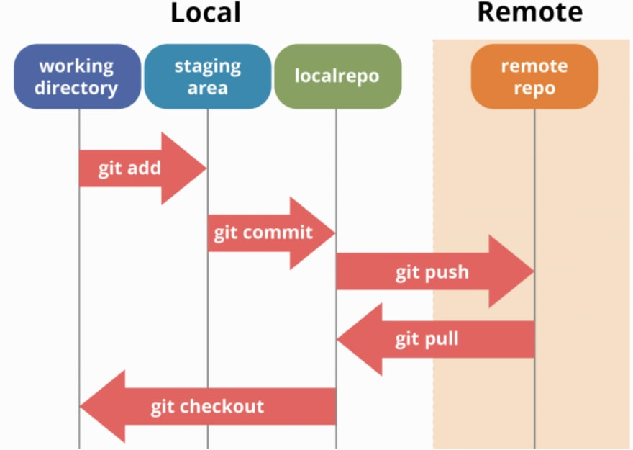
The Basics of Git
““git restore”
Notes:
This is a very basic and simple explanation for Git - this is done intentionally. Git is difficult to understand. Make sure to emphasize that it’s okay not to understand it and to ask for help if they want to understand it better, for Git issues, etc. Explain the basics, its purpose and they’ll learn to utilize what they need as the course moves on. This also serves a brief summary of the workflow if you choose to skip the previous example or for summarization purposes.

Slide 28
Lab Overview

Slide 29
An Overview
Lab 1 is due Friday, 8/30 at 11:59 pm.
Make sure to read lab 1 carefully! There’s a lot of information, so it might be difficult to digest on first pass. That’s okay! Go at your own pace and we’ll be here to help :)
Deliverables:
Arithmetic.java
Your lab setup! Make sure you’ve set up IntelliJ and have completed the setups detailed in the lab (including authentication with Beacon - more details in the spec).

Slide 30
Some Tips for Setup
You can run through this if you’re having trouble with setup (check out the FAQ too!).
When opening up your assignment through IntelliJ, make sure you select the lab folder itself, not the repository (ex. open lab01 instead of fa24-s*** directory)
Right click on the src folder → Mark Directory as → check that the src folder is marked as Sources Root
Right click on the tests folder → Mark Directory as → check that the tests folder is marked as Test Sources Root
Make sure you have the proper settings configured:
Go to File → Project Structure and check the following (in IntelliJ Ide):
Check that the language level is correct (version 17+)
Check that there is a path for Compiler Output (default is out folder)
Check that you have the library-fa24 imported under Libraries tab
If you think your setup is correct, then try going to File → Invalidate Caches and restart the IntelliJ IDE. That may help if you’re unsure where certain errors might be showing up.

